Slide 1



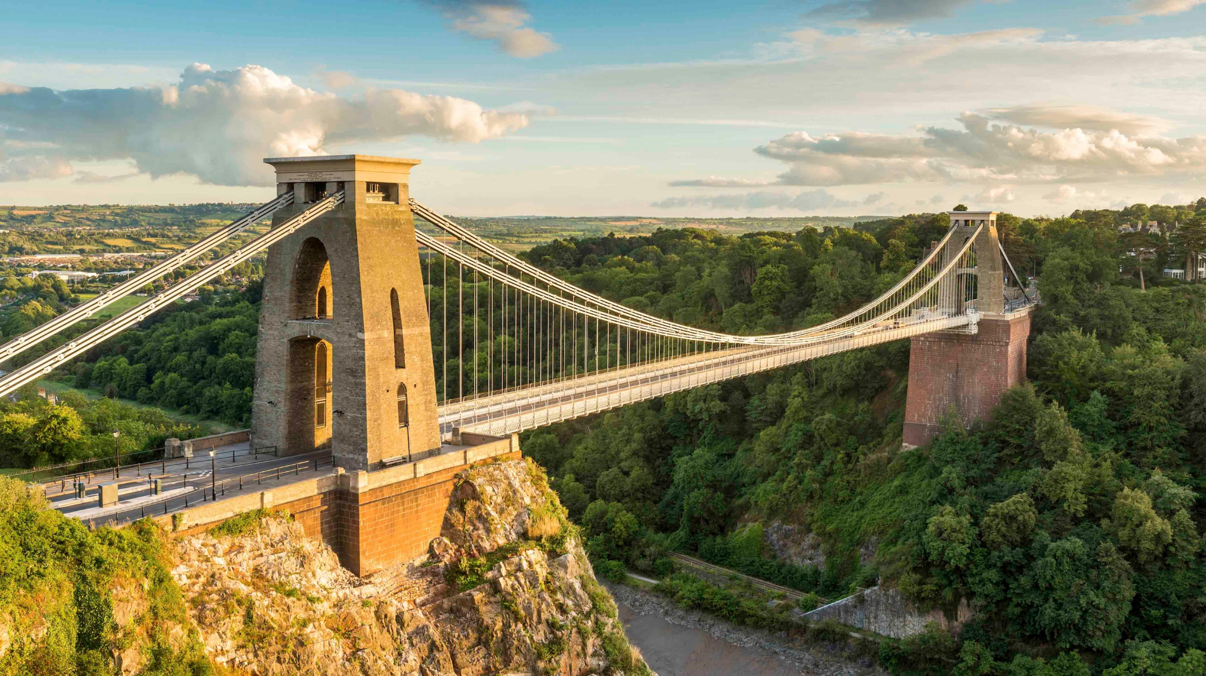
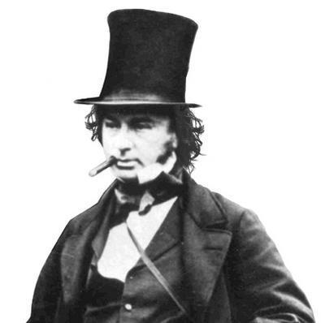
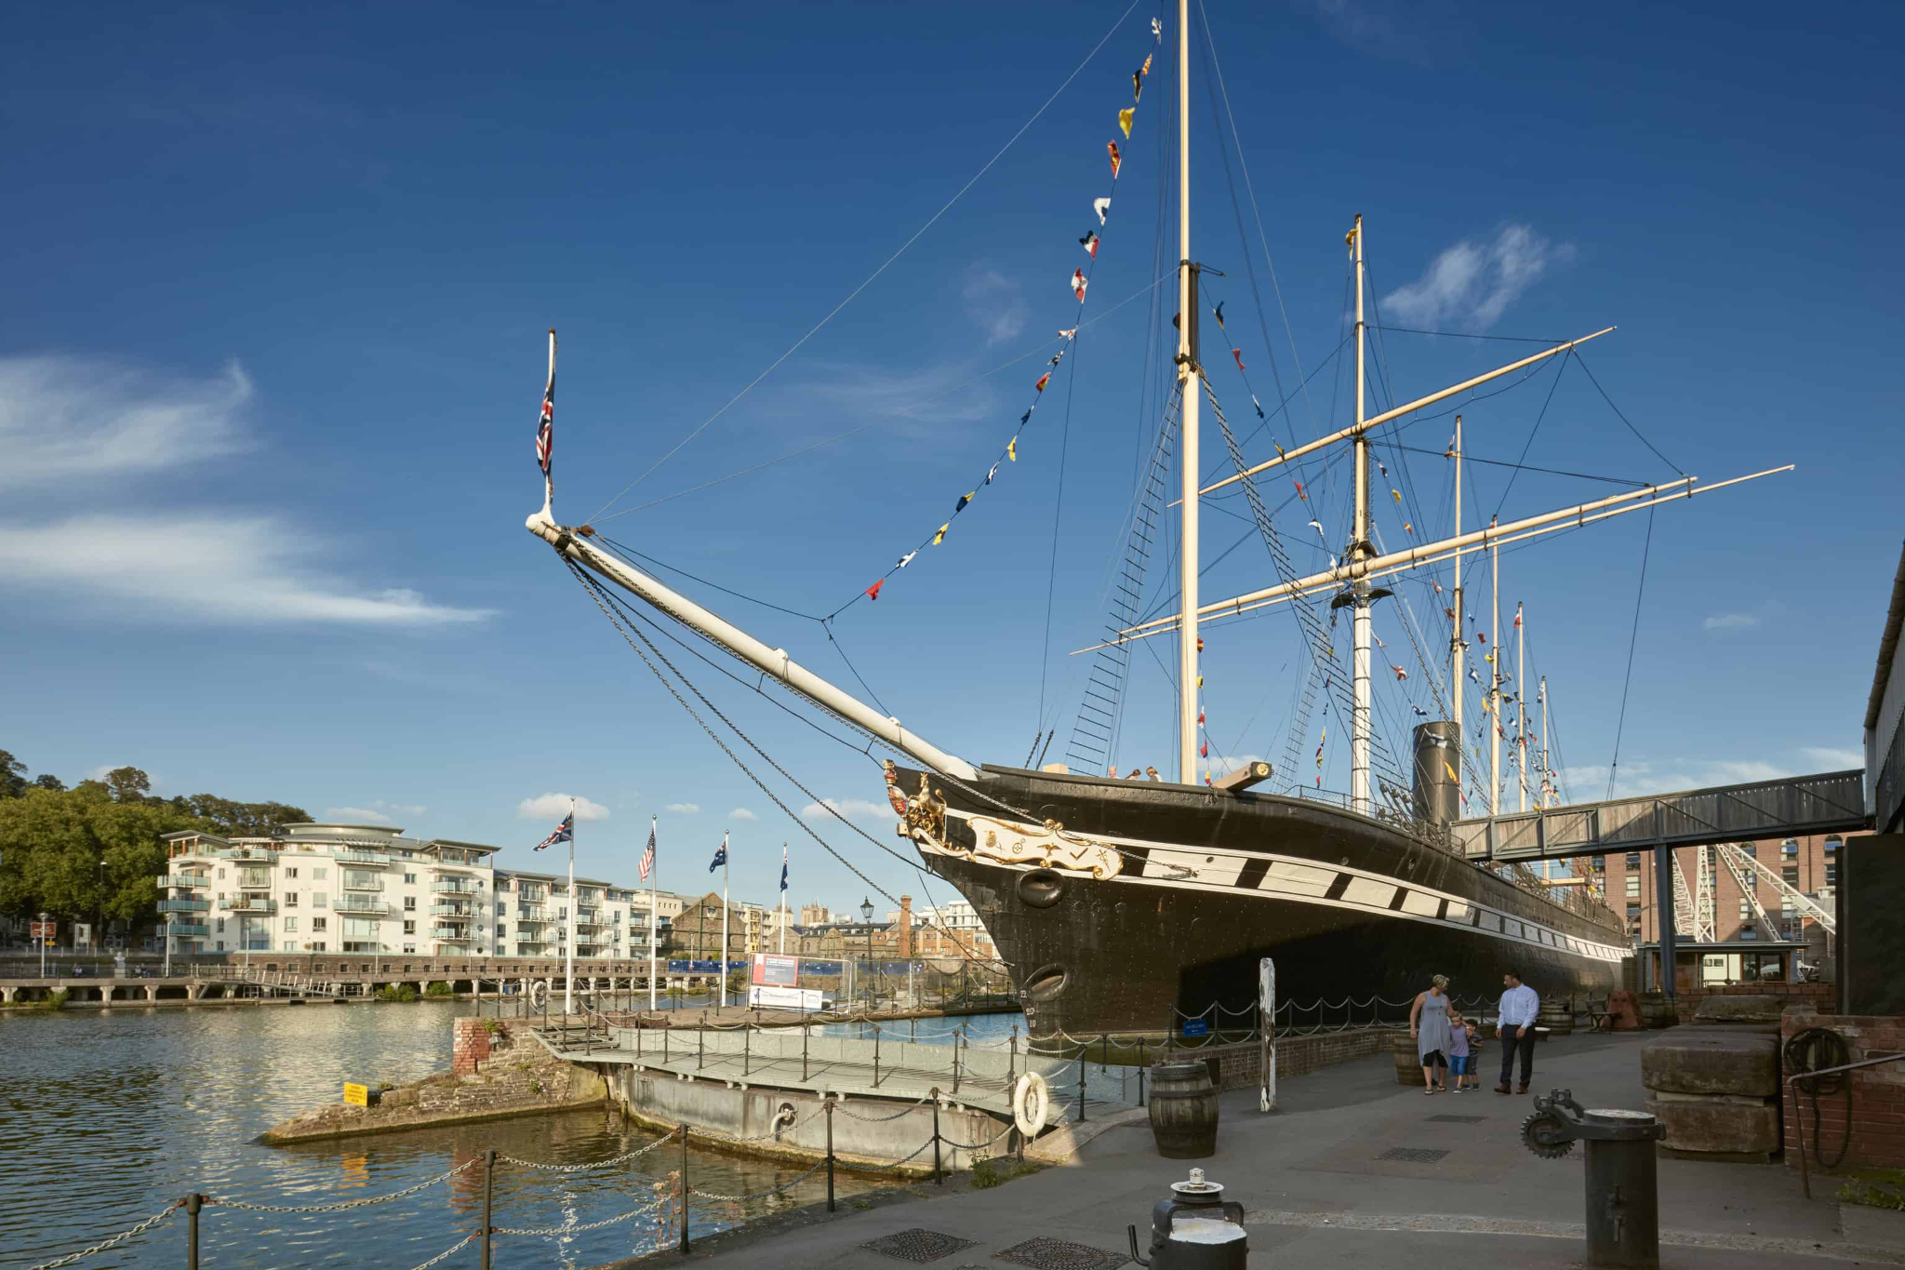
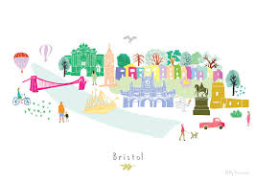

Vocabulary: Learn these words their meanings
Key Word | Definition
significance | Having a meaning or importance.
Brunel | A significant engineer who built and designed bridges such as Clifton suspension bridge and the Great Western Railway.
engineer | A person who builds or designs machines, roads, bridges or vehicles.
gorge | A narrow valley with steep sides.
Suspension bridge | A bridge that has its road suspended (held up) by 2 or more cables passing over towers and anchored at the ends.
Great Western Railway | A railway line that links Bristol to London.
SS Great Britain | A passenger and cargo ship built in Bristol by Brunel.
Bristol | A city in southwest England.
Victorian | People who live during the reign of Queen Victoria.
Phase 2 Tell Me About sheet CYCLE A Terms 1 & 2
How Did Brunel Make a Difference?
mini enquiries
What is a historian?
Who was Brunel?
What is an engineer?
How is it made?
How did Brunel make Bristol beautiful?
Impact on society
Changes over time – what and how
Primary and secondary resources
BIG IDEAS:
Materials, Processes and Investigation
Through asking questions, making predictions, gathering information and analysing evidence we can understand the physical properties of the world around us.
We can understand physical processes and we can understand how we interact with them and how they shape our world.
Within this Big Idea, our children will be exploring the concepts of:
purpose, inheritance, impact
Map work
Tell me why Brunel was a significant person?
How did the Clifton suspension bridge change the lives of people living in Bristol?
How did the Great Western Railway (GWR) make a difference to the people living in Bristol?

